Slide 1

Digital analysis of USA housing price and type
Data Mining Group 8: Shengqi Zhou ,Yichen Li, Fengshu Xu , Yangzhuopeng Yi
Apirl 14, 2020

Slide 2
USA housing Listing
Introduction
Data description and preprocessing
Methods
Results
Conclusion and remark

Slide 3

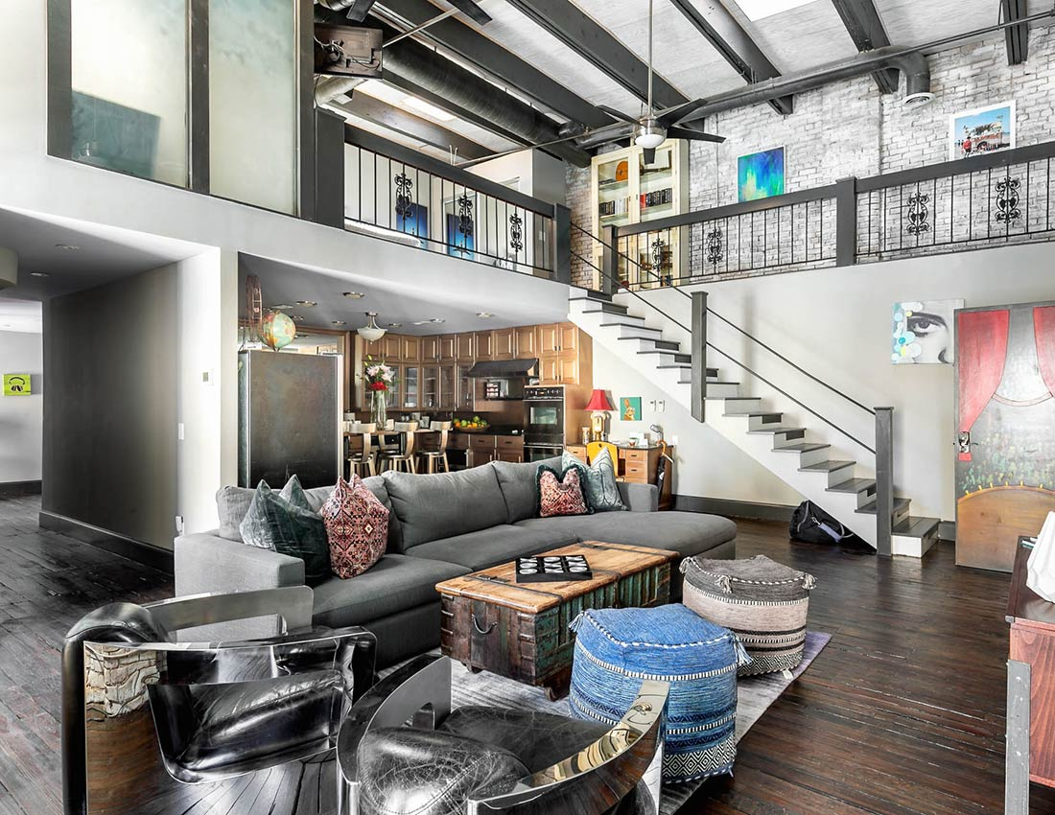

Introduction
Which one do you prefer?

Slide 4
Introduction
22 variables,384,977 observations
Numerical: rent per month, total square footage, latitude, and longitude
Categorical: number of beds, number of bathrooms, house region, house type, states, cats allowed, dogs allowed, smoking allowed, wheelchair access allowed, electric vehicle charger, comes with furniture.

Slide 5
USA housing Listing
Introduction
Data description and preprocessing
Methods
Results
Conclusion and remark

Slide 6

Data Preprocessing
Removal of unwanted variables
Handling missing data
Managing unwanted outliers
https://www.kaggle.com/austinreese/usa-housing-listings

Slide 7
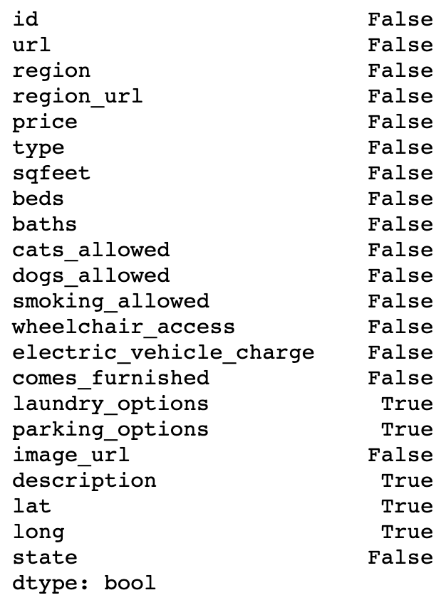
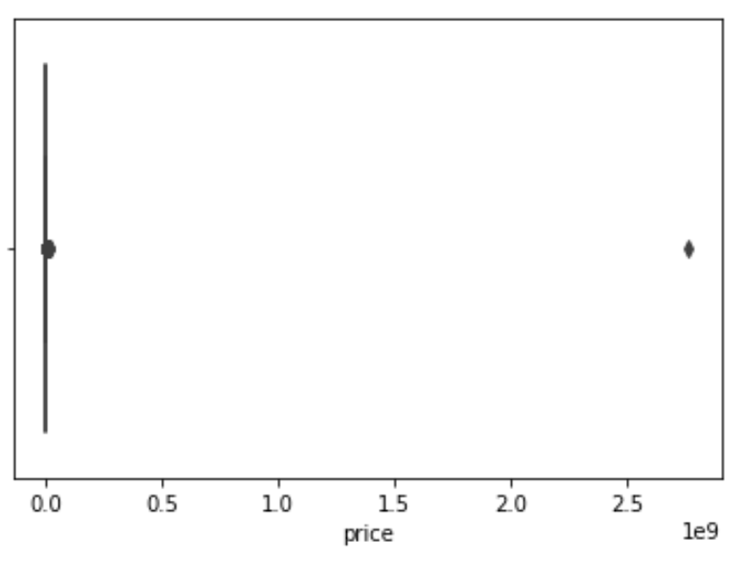
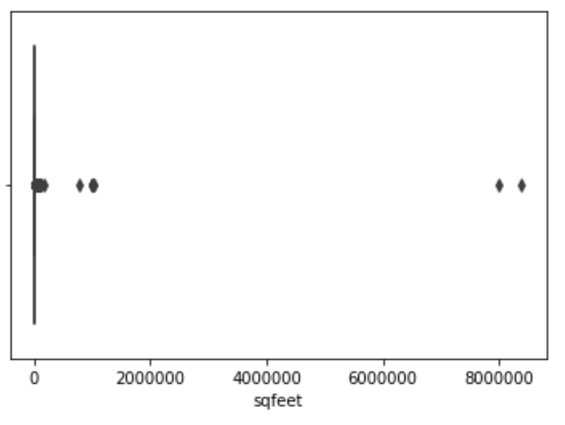
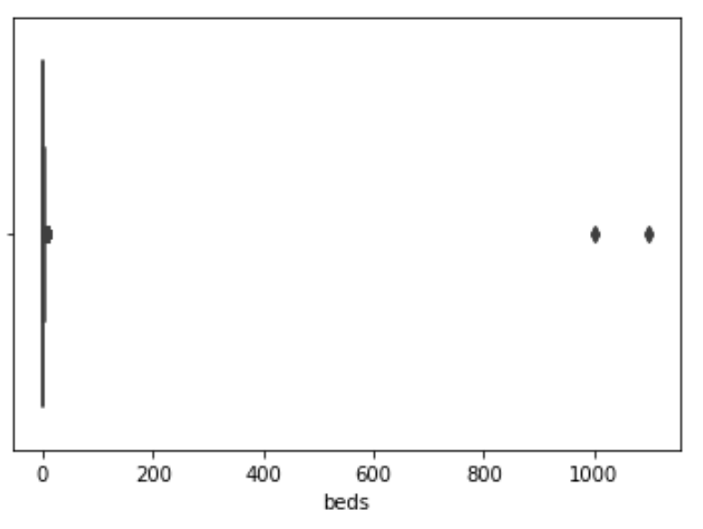
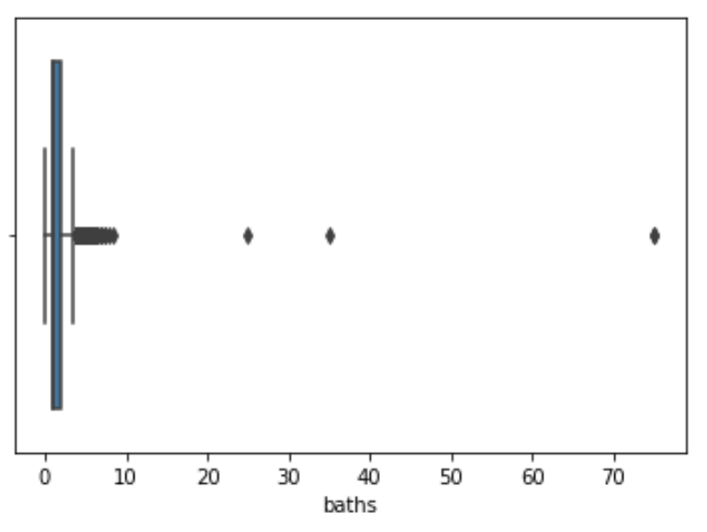
Data Preprocessing
Null Value
Outliers

Slide 8
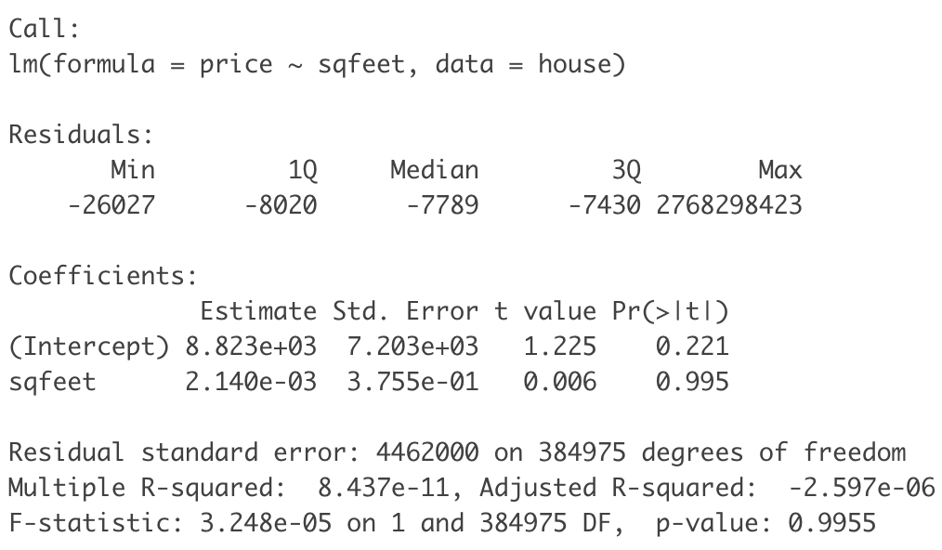
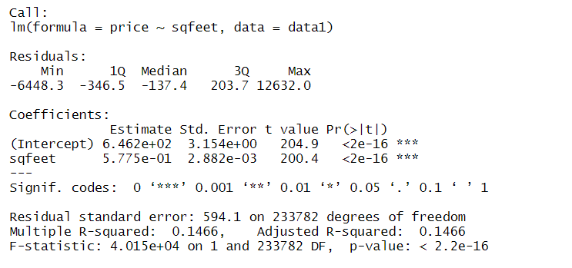
Data Preprocessing
Linear regression with outliers
Linear regression without outliers

Slide 9
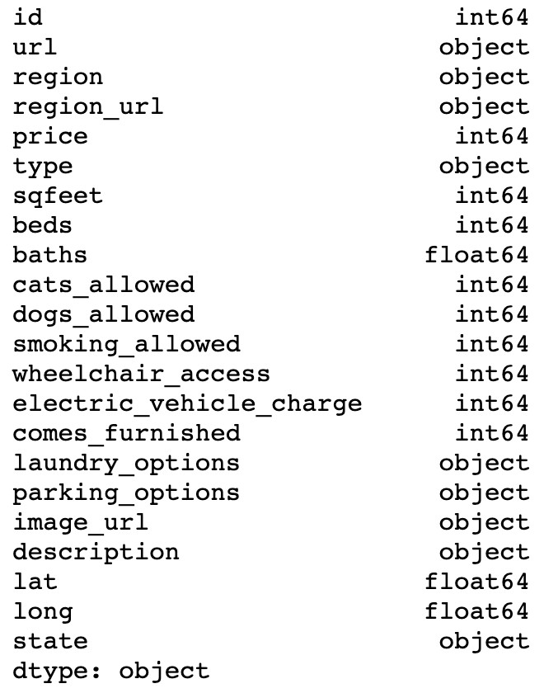
Data Preprocessing
Change data types of few variables from numerical to categorical
Unwanted columns: description, image_url
Notes:
https://tradingeconomics.com/china/employed-persons China Employed person (774710000, 26.56%)
http://factsanddetails.com/china/cat9/sub63/item348.html “There are 425 million agricultural workers (200 million farming households) in China.”
https://www.investopedia.com/articles/investing/103114/chinas-gdp-examined-servicesector-surge.asp “Massive Agricultural Sector
China is the world’s largest agricultural economy with farming, forestry, animal husbandry and fisheries accounting for approximately 10% of its GDP. This percentage is much higher than in developed countries, such as the United States, the United Kingdom, and Japan, where agriculture makes up about 1% of GDP.”
http://statisticstimes.com/economy/countries-by-gdp-sector-composition.php China as 1st Agricultural GDP

Slide 10
USA housing Listing
Introduction
Data description and preprocessing
Methods
Results
Conclusion and remark

Slide 11
Methods
Least Square? Ridge Regression? LASSO?
Variable Pre-Selection? Forward Stepwise Selection?
Linear Regression? Support Vector Machines ? KNN?
LDA & QDA? KNN classification?
Support Vector Machines (SVM)?

Slide 12
Methods
Least Square? Ridge Regression? LASSO?
Variable Pre-Selection? Forward Stepwise Selection?
Linear Regression? Support Vector Machines ? KNN
LDA & QDA? KNN classification?
Support Vector Machines (SVM)

Slide 13
USA housing Listing
Introduction
Data description and preprocessing
Methods
Results
Conclusion and remark

Slide 14
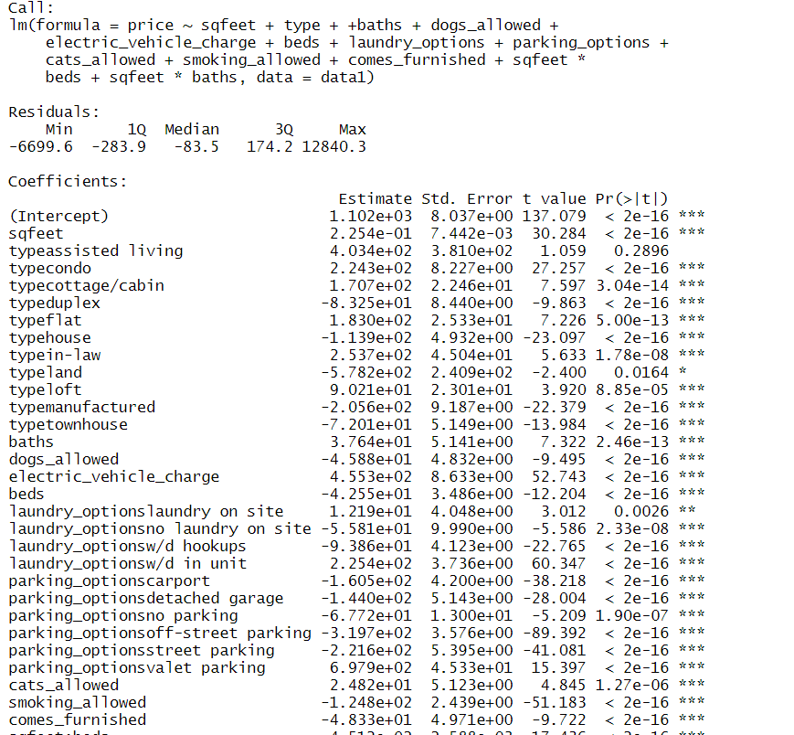
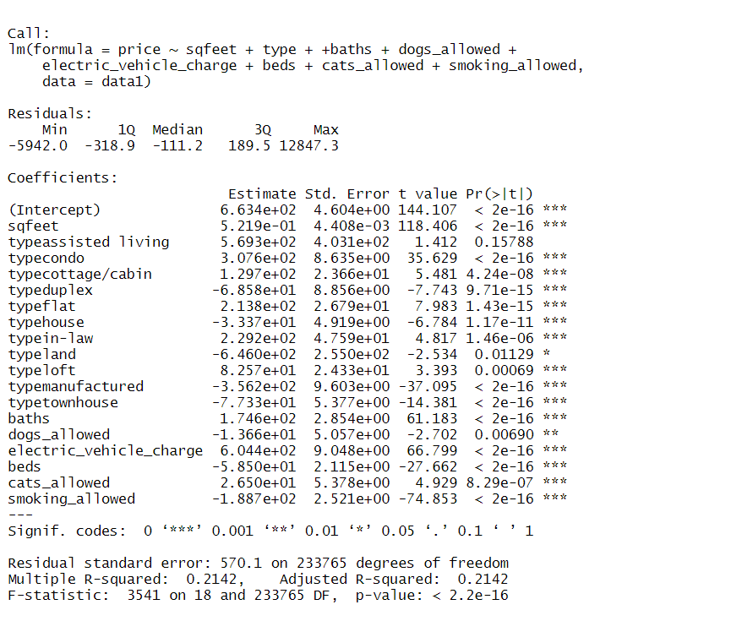
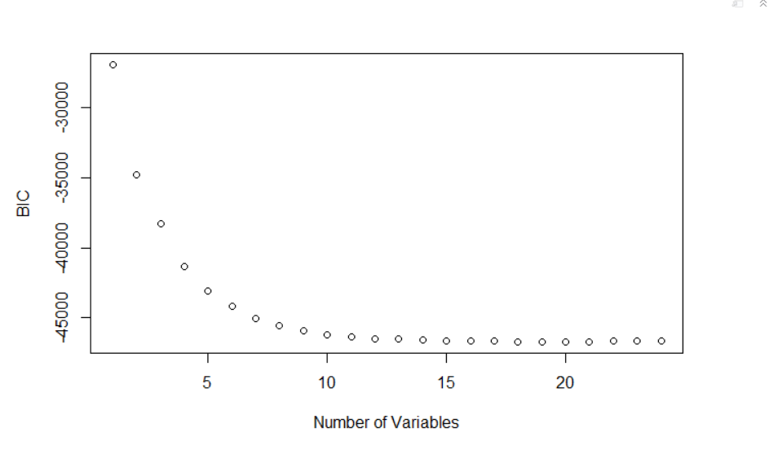
Results

Slide 15
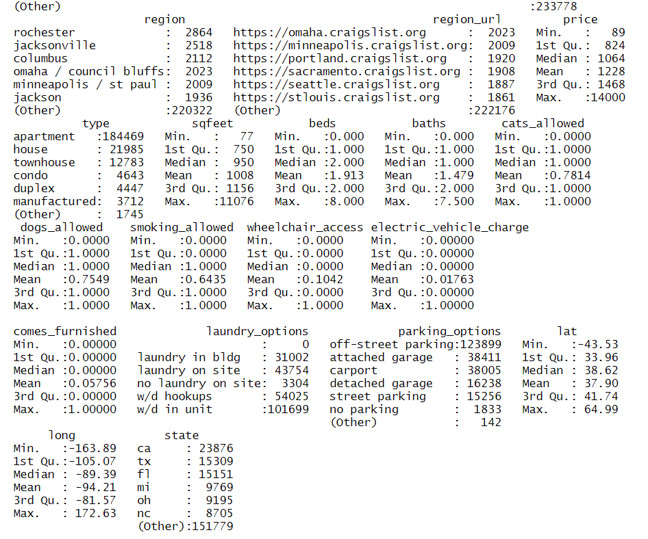
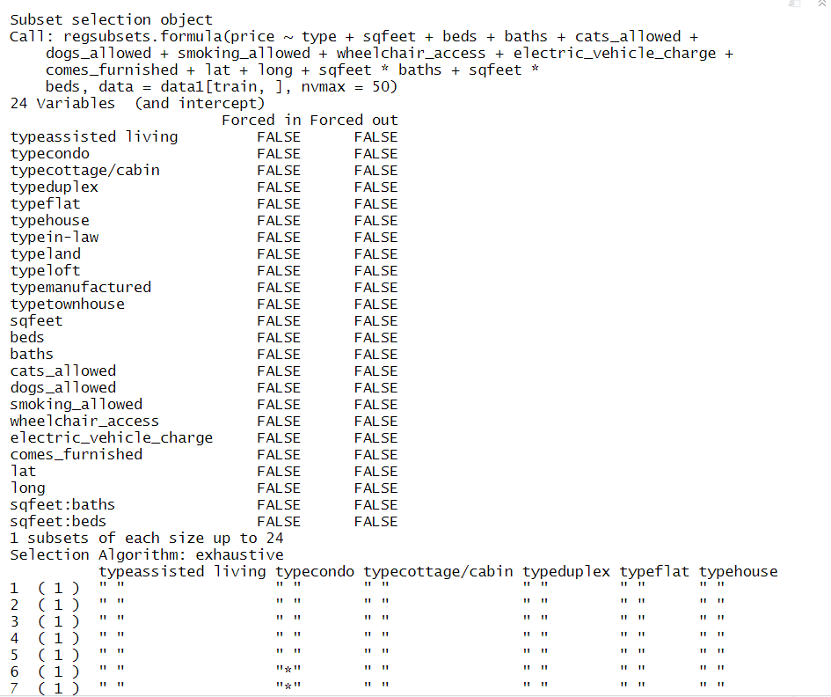
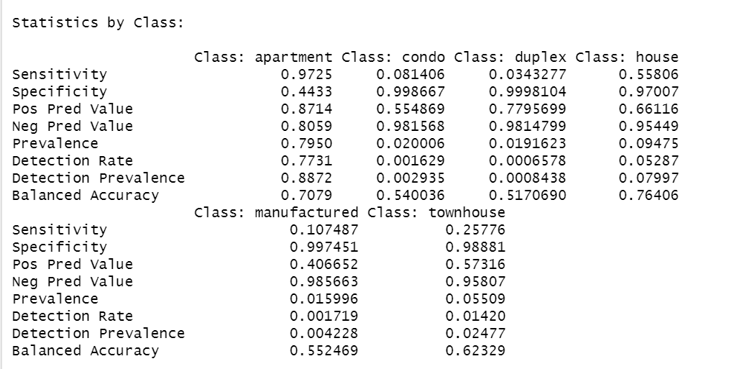
Results

Slide 16
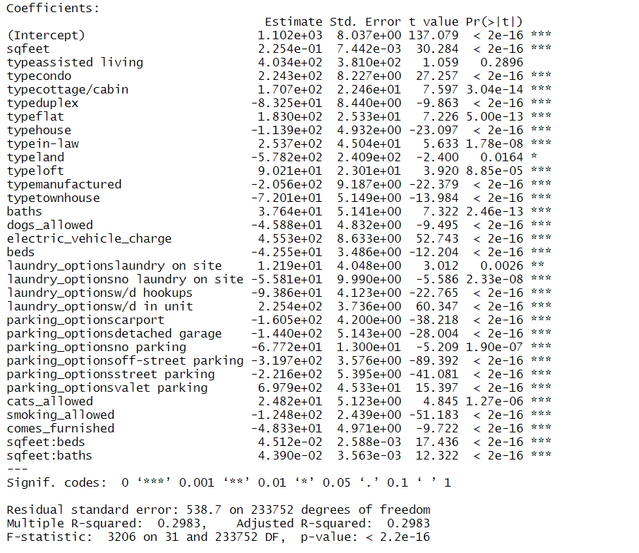
Results
Area
Housing type
Number of bathrooms
Number of beds
Dogs allowed
Cats allowed
Electric_ vehicle charge
Laundry options
Parking options
Area*Number of Beds
Area*Number of baths
Mean square test error: 4.178

Slide 17
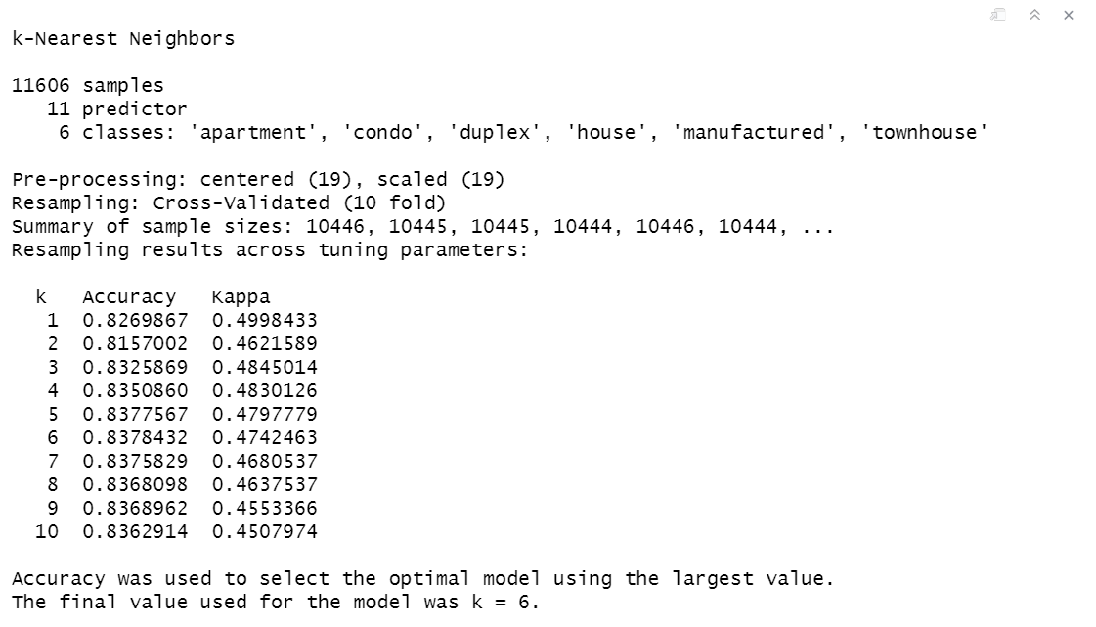
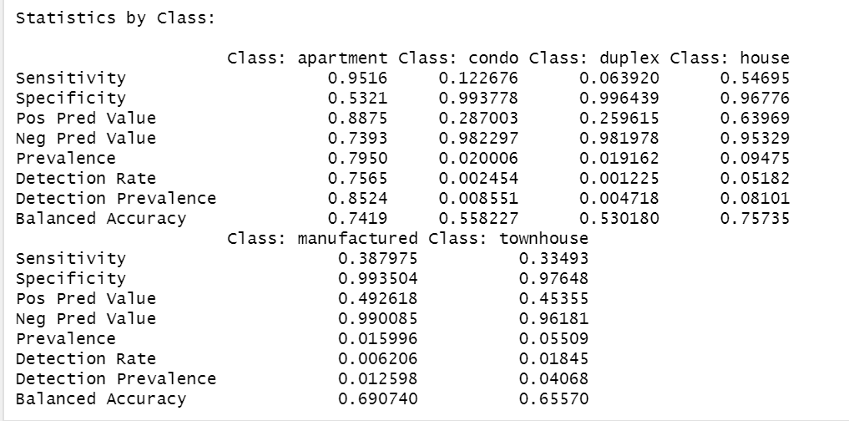
Results

Slide 18
USA housing Listing
Introduction
Data description and preprocessing
Methods
Results
Conclusion and remark

Slide 19
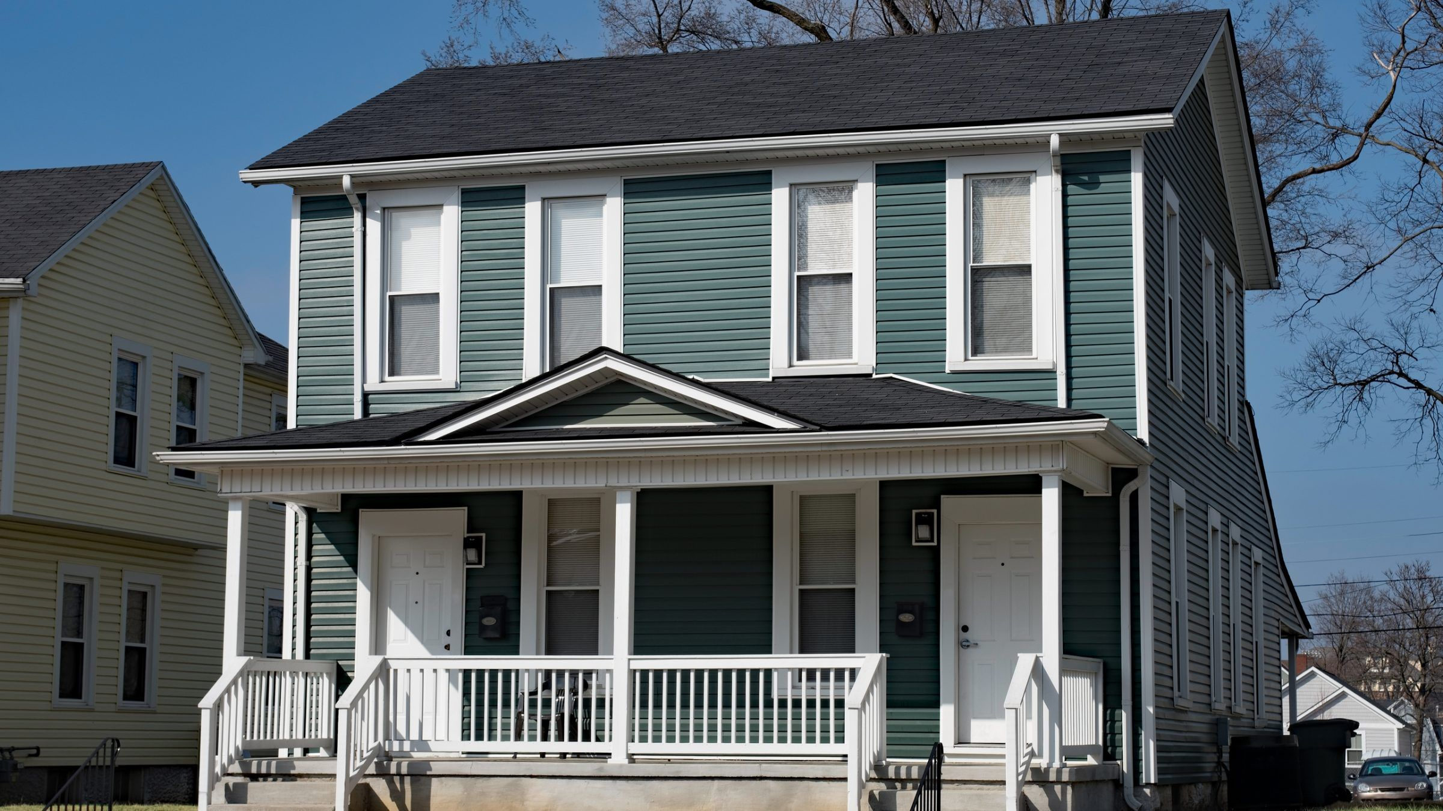
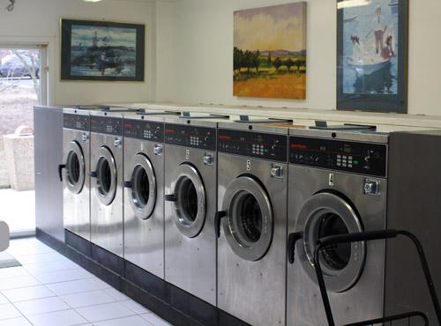
Regression Model
For property owner:
Loft
Laundary in unit
Cat vs Dog
Parking
For potential tenant:
Duplex
Laundary on site
https://reason.com/2019/12/31/virginia-bill-would-end-single-family-only-zoning-in-the-old-dominion/
http://www.oldcentrevillegardens.com/laundry.html

Slide 20

KNN
For potential tenant
https://www.searchenginewatch.com/2018/08/27/the-evolution-of-search-succeeding-in-todays-digital-ecosystem-part-2/

Slide 21

Q&A

